Slide 1
Summit meeting for key stakeholders: implementing school inclusion in Surrey
Summit sponsored by the School of Law and Social Sciences, Royal Holloway
2nd March 2022

Slide 2
Welcome
Dr Julie Llewelyn, High Sheriff of Surrey 2021-22

Slide 4
Final research project outcomes Permanent school exclusion in Surrey: evidence based key levers for change
Dr Emily Glorney, Project Lead
Royal Holloway, University of London

Slide 5
Permanent School Exclusions in Surrey
What works to keep children and young people in education?
Dr Emily Glorney, Senior Lecturer in Forensic Psychology and Project Lead
Natasha Rhoden, Research Assistant and PhD candidate
(With contributions from Professor Frank Keating, Professor of Social Work)

Slide 6
Questions
What are the characteristics of children and young people (CYP) permanently excluded from schools in Surrey?
What systems of support were around these CYP when excluded?
What concerns do professional educational stakeholders have regarding exclusion practice in Surrey?
What solutions do they generate?
What do professional educational stakeholders identify as the barriers and facilitators to best practice in managing school exclusions in Surrey?

Slide 7
Questions
What are the characteristics of children and young people (CYP) permanently excluded from schools in Surrey?
What systems of support were around these CYP when excluded?
Can we identify vulnerability and protective factors for school exclusion in Surrey?
What concerns do professional educational stakeholders have regarding exclusion practice in Surrey?
What solutions do they generate?
What do professional educational stakeholders identify as the barriers and facilitators to best practice in managing school exclusions in Surrey?

Slide 8
Evidence-based vulnerability factors for permanent school exclusion
Boys, a history of contact with social care services, from disadvantaged communities, SEN statements (Timpson Review,2019)
Adverse childhood experiences: neglect, abuse, being supported by or under the care of Local Authority services (Scottish Government, 2018)
Gypsy/Romany, Travellers of Irish heritage, Caribbean children, deprivation (Department for Education, 2017; 2019; 2020)
Mixed White/Black Caribbean children were the dual ethnicity group at highest risk of exclusion (Lewis & Demie, 2019)
Girls from Black and Mixed (White) Caribbean heritages (Agenda, 2021)
Subjective experience of social exclusion has a detrimental impact on mental health (Arslan, 2021)

Slide 9
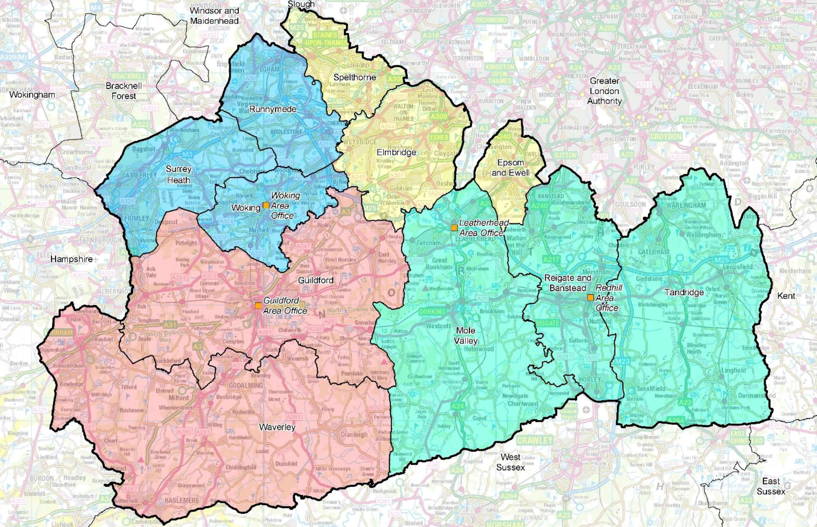

Slide 10
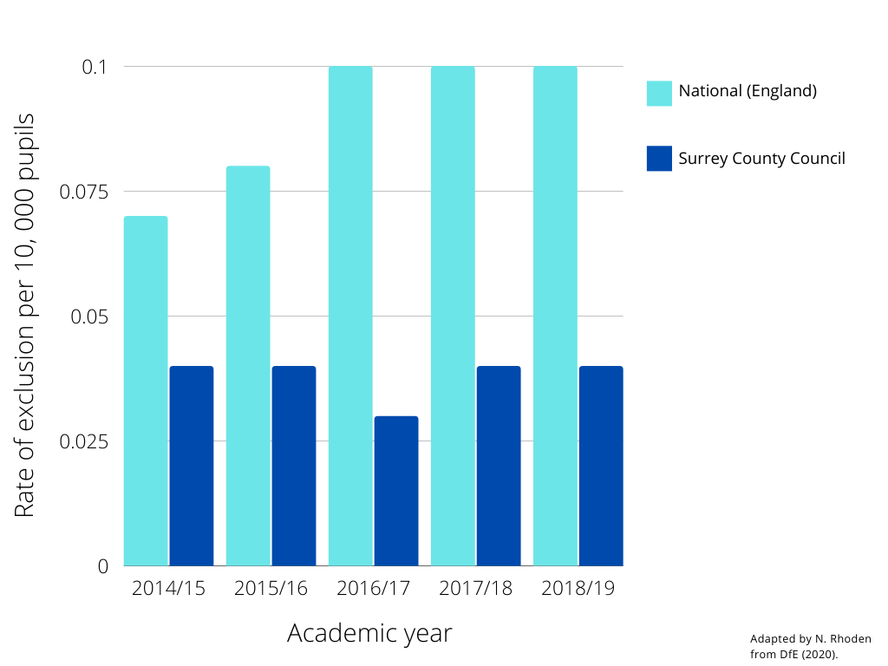

Slide 11
Recorded reasons for permanent exclusion in Surrey

Slide 12
Evidence-based vulnerability factors for permanent school exclusion
Boys, a history of contact with social care services, from disadvantaged communities, SEN statements (Timpson Review,2019)
Adverse childhood experiences: neglect, abuse, being supported by or under the care of Local Authority services (Scottish Government, 2018)
Gypsy/Romany, Travellers of Irish heritage, Caribbean children, deprivation (Department for Education, 2017; 2019; 2020)
Mixed White/Black Caribbean children were the dual ethnicity group at highest risk of exclusion (Lewis & Demie, 2019)
Girls from Black and Mixed (White) Caribbean heritages (Agenda, 2021)
93% of girls in Surrey were White; 86% White British

Slide 16
Evidence-based vulnerability factors for permanent school exclusion
Boys, a history of contact with social care services, from disadvantaged communities, SEN statements (Timpson Review,2019)
Adverse childhood experiences: neglect, abuse, being supported by or under the care of Local Authority services (Scottish Government, 2018)
Gypsy/Romany, Travellers of Irish heritage, Caribbean children, deprivation (Department for Education, 2017; 2019; 2020)
Mixed White/Black Caribbean children were the dual ethnicity group at highest risk of exclusion (Lewis & Demie, 2019)
Girls from Black and Mixed (White) Caribbean heritages (Agenda, 2021)
93% of girls in Surrey were White; 86% White British

Slide 20
Vulnerabilities to YJ/Police involvement
In comparison to non-justice-involved children and young people, young people with police and youth justice involvement at or by the time of permanent exclusion were more likely to have:
SEN support
History of early help
Current or prior child in need status
Early help and child protection status after exclusion
Children and young people on an EHCP were less likely to have contact with the police and youth justice services.

Slide 21
What is the link between fixed term and permanent exclusions?
CYP without a history of FTE (28%) | CYP with a history of FTE (72%)
Drug and alcohol related behaviour | Persistent, disruptive behaviour
Average age of 15 years (range 13-18) | Average age of 12 years (range 5-18)
Minimal YJS contact before exclusion | 40% known to police/YJS before/at exclusion
No contact with YJS/police after exclusion | 17% first contact with YJS/police after exclusion
 | 3+ vulnerabilities relating to FSM, social care, SEND

Slide 22
Key points from our data - 1
In comparison to national averages, children and young people excluded from schools in Surrey include a higher prevalence of:
Eligibility for free school meals
Social care vulnerability
Multiple needs

Slide 23
Key points from our data - 2
Most young people who were justice-involved had their first contact before or at the time of permanent exclusion.
Not all of these CYP continued to be justice-involved.
BUT: SEN support, hx early help, current/hx CiN
CYP first justice-involved after exclusion had multiple vulnerabilities
No FTE – unlikely to be justice-involved, or SEN, or FSM
FTE – YJS/police, multiple vulnerabilities

Slide 24
Conclusions
Identification and intervention for multiple needs
objective, evidence-based indicator for vulnerability to exclusion
early intervention, service engagement, services linking up with schools.
a marker for early help and child in need status. Information about behaviour support approaches and additional needs to follow children through phase transitions.
Services to work together to prevent school exclusions
SALP. How might services link to SALP? Information/data sharing.
There are possibilities of poor life trajectories identified prior to exclusion, not only as a consequence of exclusion.
attachment, nurture, trauma.

Slide 25
Emily.Glorney@rhul.ac.uk
Thank you …
Dr Julie Llewelyn, High Sheriff 2021/22, Lady (Louise) O’Connor DL, Ron Searle, Dr Jim Glover OBE DL, for guidance and support.
Mark Keiller and Sandra Morrison for guidance and facilitation.
Participants, Surrey County Council, Surrey Police, Surrey Youth Justice, NHS and third sector staff, volunteer researchers, and Carl Bussey, Jo Butler, Kirstin Butler, Jessica Clark, Gemma Neathey, Siobhan Neave, Ailsa Quinlan, Bradley Smith, Mairead Warner

Slide 26
Implementing the Inclusion Agenda The Enhanced Surrey Alternative Learning Provision (SALP)
Ron Searle, Chair of Surrey Alternative Learning Programme Central Board
Chair of Trustees Inclusive Education Trust; Former Surrey Headteacher

Slide 27
SALP
Progress since
2 July 2021
Surrey Alternative Learning Programme

Slide 28
SALP
Surrey Alternative Learning Programme
£1,247,771 devolved as Reducing Exclusions funding was used to create an additional 101 Alternative Provision placements across the county, around 80% of PRU capacity.
£12,354 per SALP placement, compared to PRU placements costing between £19,695 and £26,116 depending on top up funding by area.
Funding for the current year and for 2022/23 is agreed at £312,500 per quadrant. (£1.04 per person in Surrey)

Slide 29
SALP
Surrey Alternative Learning Programme
How is SALP structured and what are the processes?
Quadrant SALP Board
Membership: Heads of all secondary schools
Meetings: Annual in September Decision Making Meetings (£312,500), then half termly.
(What programmes will be funded? How many student places? What will be the cost to schools? Are there non-participant schools?)
Quadrant Executive SALP Committees
Membership: Headteacher rep from each borough, LA Inclusion Officer, PRU heads, FE/GFE Principals
Meetings: Half-termly
(Oversight of exclusions, placement occupancy, funding, ‘gatekeeping’ to support schools in avoiding Pex)
Central SALP Board
Membership: Independent Chair, Assistant Director for Inclusion and Additional Needs, Chairs of Quadrant Exec. Committees, LA Multi-Disciplinary Lead & Inclusion Officers,
Meetings: Half-termly
(Monitoring, evaluation, QA, accountability)

Slide 30
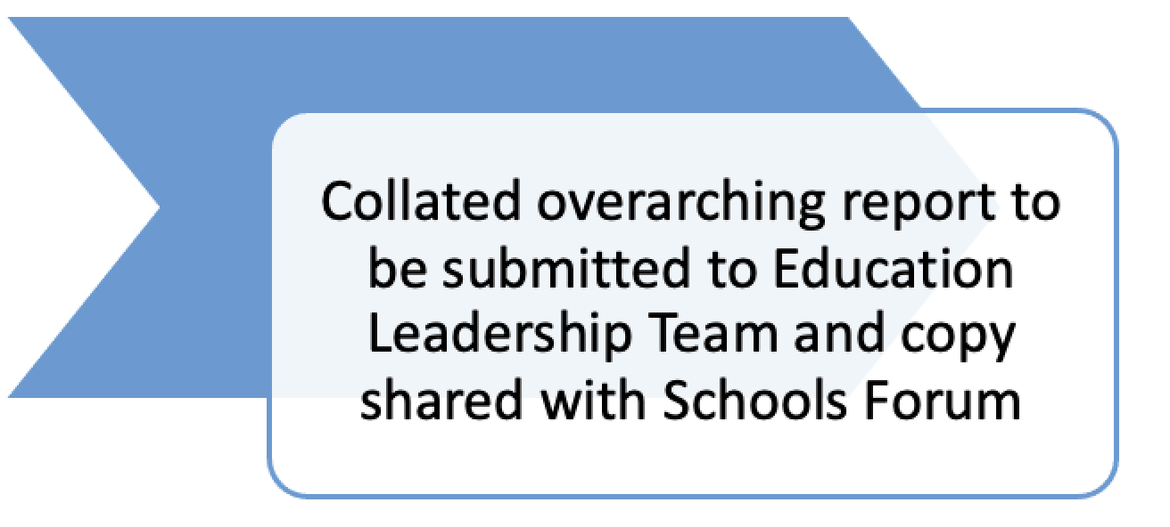
SALP
SALP Executive Board annual budget return

Slide 31
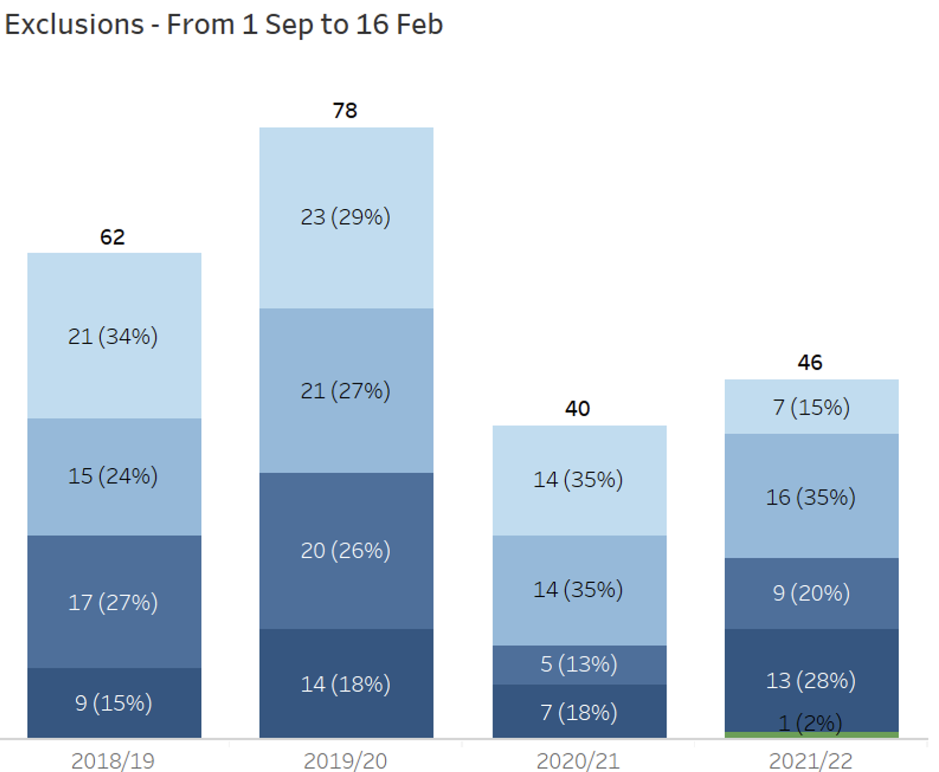
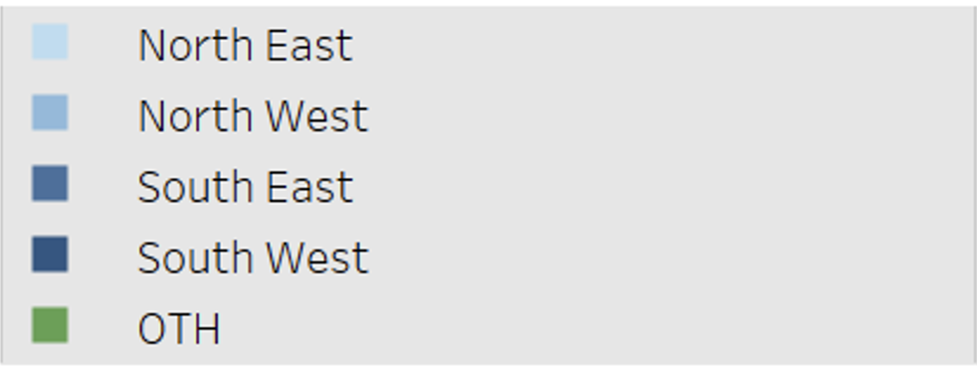
SALP
Exclusions over 3 years for the period September to 16 February

Slide 32
SALP
SALP funded provision 2020/21
STAR Project (8 students) All Year 11 students achieved GCSEs in English Language, English Literature and Maths. Bespoke CIAG and supported college applications led to 0% NEETs
Route 4 (22 students) GCSE English, Maths and a range of other qualifications.
The Well Project (12 students) supports vulnerable young people to remain in mainstream education with a bespoke package of provision that enables them to achieve academic success without the stigma of PEX.
GASP Motor Project (48 students) AQA unit award achieved by all participants Improved attendance and reduction of behaviour incidents. Better understanding of p athways into employment in the car industry

Slide 33
SALP
SALP funded provision 2020/21
The Link (10 students) who met threshold or were at risk of PEX All students have completed Eng Lit and Lang, Math’s, and Art.
Springboard (12 students) All achieved the LASER Award or Certificate for Learning, Employability and Progression Level 1 Functional Skills English Functional Skills MathsPost16 planning for all pupils with most remaining at ESC.
PLUS
KS3 Watts Gallery Intervention Programme (6 students)
KS3 PRU Federation intervention Projects (35 pupils)
Senior Learning Mentors 125 students 1:1 mentoring
Youth workers via East West. 262 The funding enabled 1595 one to one sessions and 33 support group sessions
Innervate Careers provision 608
STEPS Programme, Surrey Care Trust 1 Achieved English and Maths Functional skills and has a place at college.

Slide 34
Implementing the Inclusion Agenda Early Intervention: A new evidence based risk index to identify children at risk of permanent exclusion in Surrey. Why we need it and how it will work
Gavin Stephens QPM, Chief Constable of Surrey Police
Ron Searle, Chair of SALP Central Board
Sandra Morrison, Assistant Director Inclusion and Additional Needs, SCC

Slide 35
Critical Patterns
Chief Constable Gavin Stephens

Slide 36
What is a Critical Incident?
Any incident where the effectiveness of the police response is likely to have a significant impact on the confidence of the victim, their family and/or the community.
Notes:
a critical incident is defined as ‘any incident where the effectiveness of the police response is likely to have a significant impact on the confidence of the victim, their family and/or the community’.
If the Police aspect is taken out then the definition remains and can be child

Slide 37
What is a Critical Incident?
Any incident where the effectiveness of the our response is likely to have a significant impact on the confidence of the child, their family and/or the community.
Notes:
a critical incident is defined as ‘any incident where the effectiveness of the police response is likely to have a significant impact on the confidence of the victim, their family and/or the community’.
If the Police aspect is taken out then the definition remains and can be child
Concept of sustained public protection….must act now to prevent future threats…….

Slide 38
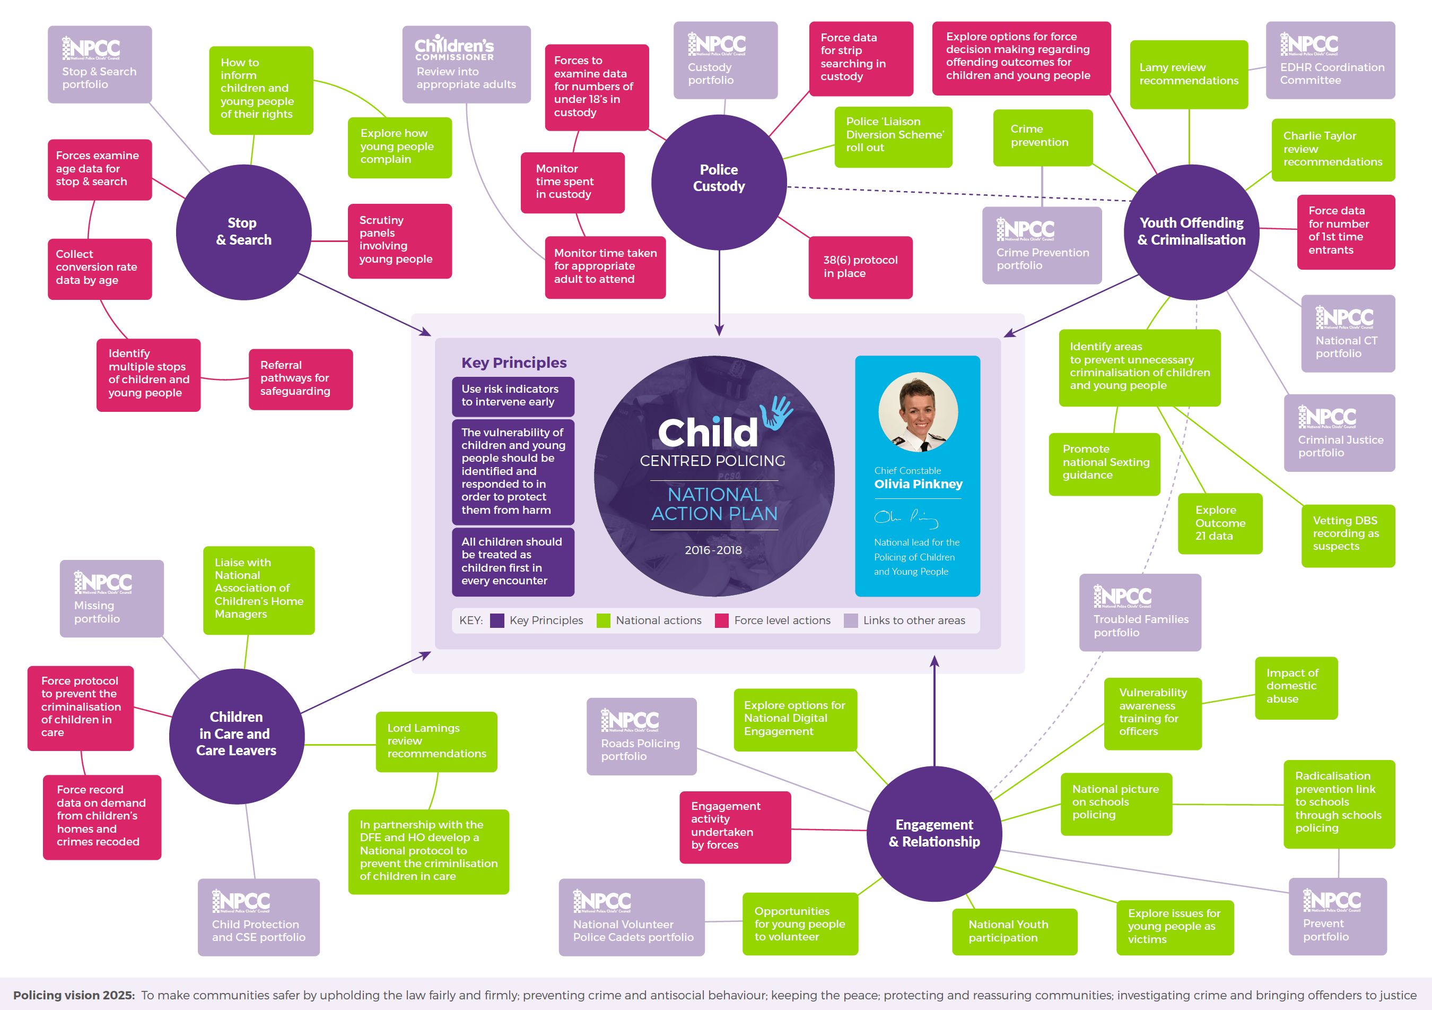

Slide 39
Notes:
A recent study by The College of Policing highlights the fact that the demand on the police service has changed significantly and we are expected to understand and deliver a range of different services for a complex society 1. It is also recognised that as financial constraints continue to affect the shape of the organisation the challenges we face become greater. An ability to reduce the demand coming into the service is essential in maintaining the service we currently provide
For C&YP this is particularly relevant as we know that early identification of vulnerability and reducing their exposure to harm will have a significant impact. We understand more clearly the issues of mental health, domestic abuse and child sexual exploitation and recognise that young people are as much at risk of this as adults are. However, there is still more that we can do
Policing is changing. As communities become more socially mobile through technology and engagement changes the police service must keep up to date with the young community we serve and evolve with them.

Slide 40
Key Principles
Treat as children first
Identify and respond to vulnerability
Fully understand the circumstances
Treat every interaction as an intervention and opportunity
Listen
Utilise alternative disposals
Notes:
It is crucial that in all encounters with the police those below the age of 18 should be treated as children first. All officers must have regard to their safety, welfare and well-being as required under S10 and S11 of the Children Act 20042 and the United Nations Convention on the Rights of the Child
. • The vulnerability of C&YP should be identified and responded to effectively in order to protect them from harm.
• In all situations where C&YP come to the attention of the police a full understanding of their circumstances should be sought. It is unusual for a young person to be a serious offender without being a victim of circumstance or offending themselves. This may not affect the way we utilise the criminal justice system but should open our eyes to alternative avenues for addressing their behaviour.
• Every interaction is both an intervention and an opportunity. Engagement should be positive and opportunities sought to enhance our relationship with them. This is where we could be identifying the critical incident before it happens or whilst it is happening.
• The voices of C&YP must be heard and their opinions respected.
• Policing supports YJB’s evidence-based practice by keeping C&YP out of the criminal justice process unless necessary

Slide 41
Identifying Critical Patterns
Notes:
As Police then identifying the critical incident that leads to exclusion is difficult. As stated in the report most children had their first contact with Police and youth justice services before or at the time of permanent exclusion.
We therefore have to stick to our principles and continue to engage as per the principles previously mentioned.
The reports also highlights the recommendations to Ensure ‘critical patterns’ of at-risk behaviours and events about children are shared between agencies to prevent escalation to ‘critical incidents’ that require a justice response.

Slide 42
Child Exploitation and Missing Unit (CEMU)
Prevention work:
Identify through potential critical incidents ie missing, crime
SPOC visits
Partner Agency referrals
CAWN notices
Risk Management Meetings (RMM)
Engagement with Social Workers
Review and debrief of incidents
Care home SPOC
Workload:
Around 180 open occurrences involving over 100 children with an engagement rate of 75%
Other engagement opportunities:
19.4% stop and search were children
Every one is scrutinised by a board where other vulnerabilities may be highlighted.
Notes:
The key aspects is engagement with the Child and this is where the CEMU comes in.
They have sometimes daily contact with the children involved and get involved.
A recent case highlighted a child that was to be excluded from school. Our information from the Officer was that they were involved in County Lines and due to an incident of fighting at school was due to be excluded. The officer worked with the school which indicated that this had been an unusual pattern of behaviour and by keeping the child in school, all agencies knew their location and exactly what they were doing, therefore safeguarding from possible exploitation should they have time on their hands.
Another led to a problem solving exercise.

Slide 43
CEMU Case Study – Problem Solving
Intelligence that a Hotel was being used for prostitution purposes
In particularly 2, 16 year old females who were school excluded
Observations carried out
Children safeguarded and information gained, suspects identified and investigated.
Led to Op Protect – Police Cadets are utilised to book hotel rooms with Police Officers. Staff are debriefed and hotel safeguarding leads are involved.

Slide 44
CEMU Case Study – Problem Solving
X was a regular MISPER from age 15 to 16
Looked at lifestyle which indicated County Lines
Interventions not successful
School excluded
Led to charges for drug supply and was exploiting vulnerable adults
Awaits trial
Whilst intervention did not work, show that we identify

Slide 45
Checkpoint Team Manager (Force Youth Justice Lead)
Youth Team:
Police Sergeant
2 Police Constables
Administrator
Implement the Youth Restorative Intervention Scheme (YRI)
Weekly joint decision making panel – Multi agency
Delivery of YRI is managed by Target Youth Support (TYS)
12.1% Outcomes through YRI opposed to 5.3% charged/summonsed
Custody:
2021 - 651
2020 - 773
2014 - 1400
Notes:
The Youth team sits within Checkpoint team. We have a Police Sgt, two PC’s and an administrator who deal specifically with young people and are the YOS function for the force as set in statute. I am also the youth Justice lead for the force so have an overview of all things Criminal Justice for young people.
We run the Youth Restorative Intervention scheme (YRI). All youth crime must come to us unless it is indictable only or the officer is seeking a remind in custody.
Weekly we hold a Joint Decision-making panel which I co-chair with the lead from Target Youth Support (TYS) from SCC. In the meeting are also CJLDS, a lead mental heath practitioner from the Mindful service, support administration from TYS who do the background checks on the young people. A police Sgt from my team runs the meeting and also present on an invitation basis are social workers, and anyone else who is working with individual young people including child services, Police YEO’s and teachers. Every young person is discussed, the details of the offence including photos and video evidence. The views of the victim and all the background that is known of the young person is heard. A decision is then made by myself and the co-chair.
The actual YRI is an out of court disposal that is closed as an outcome 8 unless it’s a non admission in which case it’s an outcome 22 (deferred prosecution). The panel can also choose other outcomes including conditional caution or charge.
The majority of cases are given a YRI, the intention of the scheme is to keep young people out of the criminal justice system by providing support and intervention through the structure of the YRI agreement.
The YRI itself is managed and delivered by TYS who put together a series of interventions based on an assessment designed to target the reason for offending and address any needs of the victim.
The team provide a YOS partnership with SCC TYS, we sign up all the condition cautions, provide background checks for bail applications and for warning markers for TYS home visits. Do physical address visits for suitability for bail. Work with YEO’s on joint visits for young people on the edge of crime or ASB.
We also run the Daily Risk Briefing. This is a daily morning meeting to discuss with partners all young people arrested and brought into custody in the last 24hrs. Any relevant intelligence and high Risk/Vulnerable Young Person mentioned on the Chief Log. The meeting is between a manager or Seconded Probation Officer representing the TYS (Central YOS Team), one of the two Surrey Police representatives linked to Surrey YOS or the Sgt who oversees them and other partnership agencies. The aim is sharing of information, to safeguard children and the public.
I sit on the force Children and Young person Policing board chaired by ACC Barlow. I also attend the regional Children and young person’s board. Both boards work to the National Child Centred Policing Best Practice Framework. This aims to ensure all forces are working to the same way of interacting with Young People. Various actions come out of those boards.
We also take part in National work in connection with young people, such as the review into the gravity matrix that’s currently being done and we are on the task and finish group.

Slide 48
Early Identification:
What are the indicators that a young person is at risk of permanent exclusion?

Slide 49
Early Identification
How Surrey addressed the NEET issue.
In Surrey, NEET levels more than halved from 2009 to 2014. The reduction in NEET levels from 2011-12 to 2012-13 alone resulted in savings of £7m to the public purse
59% reduction in young people who were NEET from 2009 to 2014. Surrey had in 2014 the joint lowest number in England, whereas in 2013 they were joint twenty-fifth (out of 152 local authorities)
90% reduction in the number of first-time entrants of young people to the criminal justice system from 2009 to 2013, resulting in Surrey having the lowest rate in England
90% figure of successful progression to education, training or employment among those who were at risk of being NEET and who received support from the Year 11/12 Transition Commission.
(Local action on health inequalities: Reducing the
number of young people not in employment,
education or training (NEET), Public Health England/UCL (2014)

Slide 50
Early Identification
How Surrey addressed the NEET issue.
In 2021, the % of young people in Surrey who were NEET stood at 1.4%.
13th of 152 Local Authorities.

Slide 51
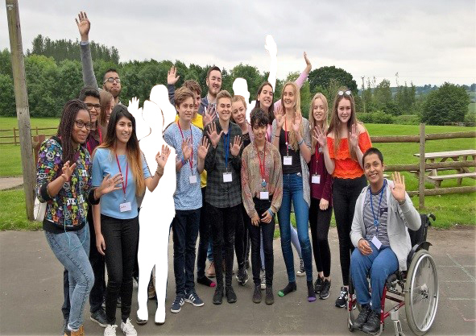
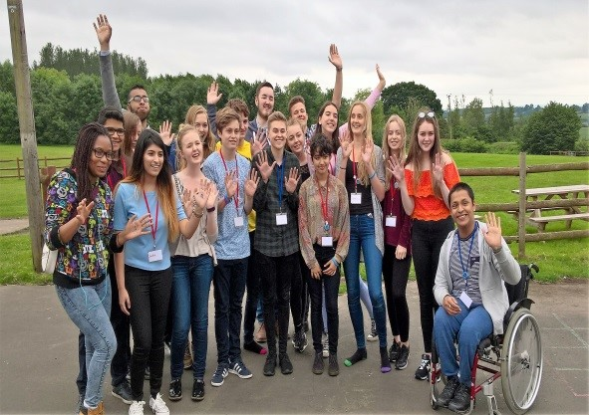
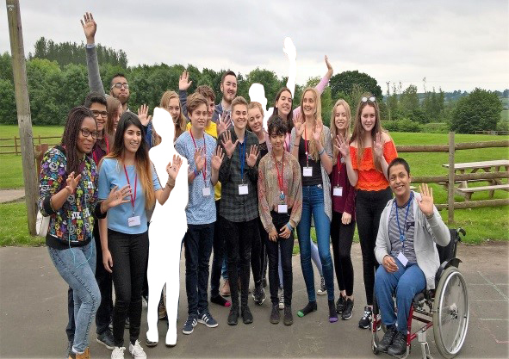
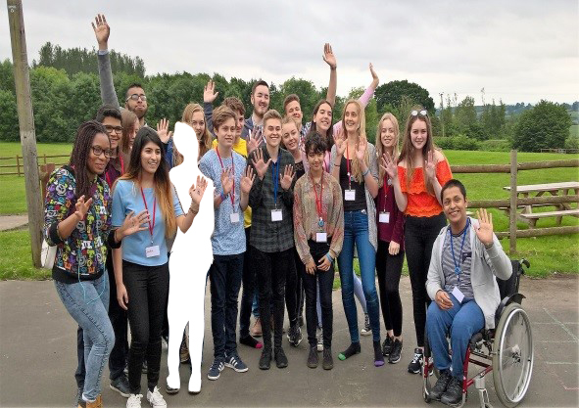
What was our target for young people being in
employment, education of training?
100%

Slide 52
How did we identify those at risk?
Primary factors:
Looked After by Surrey County Council
Young offender
Permanent exclusion from school
Attendance less than 80%
Secondary factors
SEND
Fixed-Term Exclusion from School
Eligible for FSM
English as an additional language (EAL)
Did not achieve level 4 English and Maths at Key Stage 2
Lives in an area in the top 30% of the Income Deprivation Affecting Children Indices (IDACI)
A member of the Gypsy, Roma and Traveller (GRT) community.
Other factors
teenage parents or pregnancy;
young carers;
family issues, like bereavement or parental separation;
substance misuse issues;
mental health issues; and
other health issues.

Slide 53
How did we identify those at risk?
Those who have one or more primary risk factors, or three or more secondary risk factors, are considered to be at risk of becoming NEET.
Because these measurable factors do not provide a completely accurate mechanism of identifying those at risk 'other factors’ that are likely to impact educational progress are taken into account.
RONI
Risk of NEET Indicator

Slide 54
Is Permanent exclusion a critical incident?
The outcomes?
Over one third of children who completed Key Stage 4 in Alternative Provision go on to be NEET.
1.5% of LA pupils in AP achieve 4+ in English and Mathematics pre 16 years are Boys
Increased evidence of mental health issues in students excluded from schools.

Slide 55
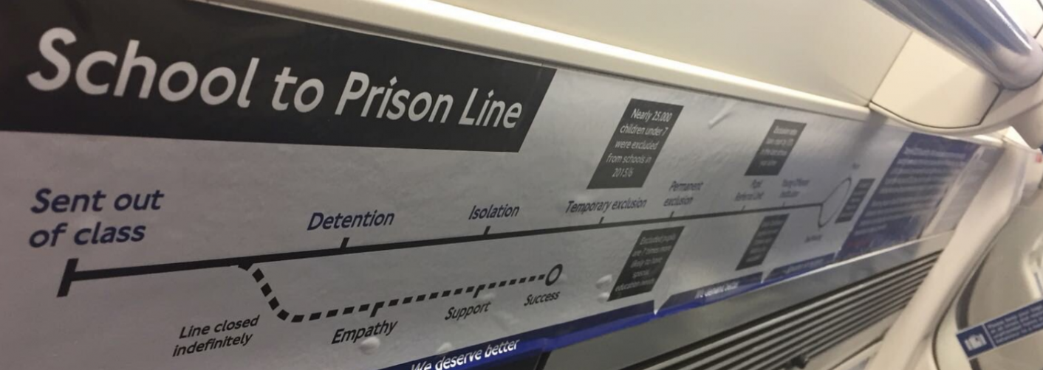
Is Permanent exclusion a critical incident?
23% of young offenders sentenced to less than 12 months in custody, in 2014, had been permanently excluded from school prior to their sentence date.1
Almost 66% of adult prisoners reported having been fixed term exclude from school.
Nearly 50% of adult prisoners had been permanently excluded. 2
1. (Timpson Report on School Exclusion (May 2019) DfE)
2. (Ministry of Justice 2012)

Slide 56
ROPEXI
Who?
SEND
Mental Health Problems
Boys
Financially disadvantaged pupils
Those in deprived areas
Looked After
(Menzies, L., & Baars, S., ‘Young People on the Margins’ (2021) Routledge)

Slide 57
ROPEXI
Who – Nationally
78% of permanent exclusions issued were to pupils who either had SEN, were classified as children in need or were eligible for free school meals.
11% of permanent exclusions were to pupils who had all three characteristics.
(Timpson Report on School Exclusion (May 2019) DfE)

Slide 58
ROPEXI
The Royal Holloway University of London Reports the following characteristics for Surrey:
free school meals (commonly used as an indicator of deprivation)
involved with social care
SEND
CIP/CP
Look After Child
“It was most common among our Surrey young people to have two identified needs. However, 29% of Surrey excluded children and young people had… three needs pertaining to SEN, FSM and social care, a much greater figure than the national picture presented in the Timpson report.
”PERMANENT SCHOOL EXCLUSIONS IN SURREY:
WHAT WORKS TO KEEP CHILDREN AND YOUNG
PEOPLE IN EDUCATION?” RHUL (2021)

Slide 59
ROPEXI
What are we going to do?
Identify young people who meet our Surrey characteristics
Work with schools to prioritise the young people who have the characteristics
Assess how big is the cohort who maybe at risk
Align other initiatives, such as Team Around the School

Slide 60
Implementing the Inclusion Agenda Panel Discussion Gavin Stephens, QPM. Chief Constable of Surrey Police Ron Searle, Chair of SALP Central Board Dr Emily Glorney, Royal Holloway, University of London Rachael Wardell, Executive Director for Children, Families and Lifelong Learning, Surrey County Council
Facilitated by Dr Jim Glover OBE

Slide 61
Tea, cakes and fruit Enjoy!

Slide 62
The Importance of Preventing Children Falling Through the Gaps in Education
Anne Longfield, CBE
Former Children’s Commissioner for England

Slide 63
Harnessing Third Sector Support MCR Pathways: An evidence based pilot study in Surrey using the holistic Glasgow approach
Iain MacRitchie, Founder of MCR Pathways

Slide 67
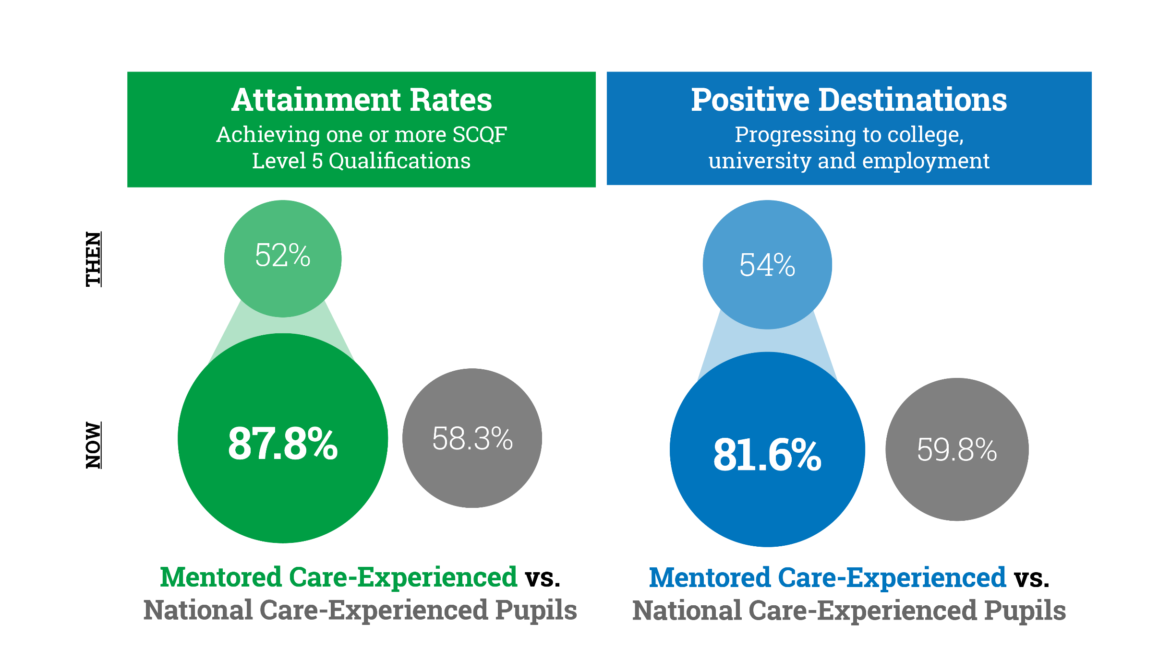
Independent Research on MCR Impact

Slide 69
Harnessing Third Sector Support The Role of the Third Sector in Surrey: the post pandemic mental health challenges
Dr Rebecca Bowden
Chief Executive of the Community Foundation for Surrey

Slide 70
The role of the third sector in Surrey – the post-pandemic mental health challenge
Dr Rebecca Bowden, Chief Executive
Rebecca.Bowden@cfsurrey.org.uk
www.cfsurrey.org.uk

Slide 71
Overview
Community Foundation for Surrey
When we come together across sectors to crack a problem we can achieve more than the sum of our parts!
Overview of CFS
Current challenge in mental health
CFS’s response and a call to arms

Slide 72
Our vision for the future is of a Surrey where all communities work together to ensure that everyone has hope and no one is left behind.
What is the Community Foundation for Surrey?
Independent charitable foundation
47 CFs in the UK, many thousands globally
Bring together donors with charities and community organisations working to address the hidden problems in our communities
Focus on grassroots, local support
Average grant £7k; YTD £2.3M
Awarded over £15M since 2005

Slide 73
Our Funds
Children & Youth
Employment
Sports
Older People
Disability
Mental Health
Environment
Homelessness
Geographic funds
Poverty
86 Funds

Slide 74
Surrey Coronavirus Fund
Together We Can
26th March 2020 Fund launched
1st April First grant awards
26th June £1million awarded
21st Sept £2million awarded
Surrey Community Fund relaunched
to continue support
Coronavirus Response Fund raised £2.75M of which £1.53M was from Surrey Donors
Notes:
Isolation
Mental Health and Wellbeing
Disability
Older people
Housing and homelessness
Debt
Employment
Isolated older people
Young People
Domestic Abuse

Slide 75
We are building a strong movement of local philanthropists, connecting them with local charitable organisations to ensure everyone has hope.
Together for Lasting Change - Partnership
We will not waste time – we will explain funding priorities & eligibility clearly
We will ask for relevant info, but no more
We will listen to our community and act with urgency
We will be open and transparent
We will learn alongside our donors and grant recipients
We will be flexible to changing priorities and needs
We will focus on enabling lasting change and be realistic about our reporting requirements
We will give applicants the freedom to bring solutions to us
We will support our donors through their lifetime of giving
We will convene partners to facilitate working together to address our biggest challenges

Slide 76
Impact of the Covid pandemic on families in mental health crisis in Surrey
We need a step-change difference in wrap-around Mental Health support for children, young people and their families suffering in Surrey
Applications to CFS for projects supporting mental health up 260%
Bereavement – increased incidence, lack of long-term holistic support for bereaved family
Lack of support for families with a child with significant MH challenges, 2 year wait for CAMHs, no holistic long-term support
Significant increase in the demand for counselling and family support across the county post-Covid; struggle to recruit qualified counsellors
Historic lack of MH support for primary age children – no charities working in this space because no funding in this space – self-harming and eating disorders dramatically increase in this age-range during lockdown
47% increase in hospital admissions of under 16s due to eating disorders in the last 12 mnths

Slide 77
Funding differently
How can CFS support?
We support many brilliant small community organisations working with young people.
We have 4 different funds giving grants to projects for Mental Health support.
We struggle to get applications in because all funding is short-term.
To date
Funding step-change
Convening

Slide 78
Listening, convening, call to arms
How will we bring about change 1
Listening to charities and community groups about funding gaps
Listen to public and voluntary sector on where the needs are
Learn from what has been funded in the last 2 years – what works and how can we nurture and grow those programmes
Work in synergy with the public sector reforms

Slide 79
Funding differently
How will we bring about change 2
5 year grant funding – enable work to get properly off the ground
larger grants (£50+ p.a.) to enable significant change
Target £2M – already raised £0.6M and SCC agreed to Match
Giving Circle – donors learn alongside grant-recipients

Slide 80
What will success look like?
How will we bring about change 3
Specifically fund projects that enable a step-change
e.g. Collaborations between a number of organisations to share best-practice
e.g. Supporting scale-up – taking good ideas to a wider geographic area or significantly expanding number of beneficiaries reached
volunteer Funder Plus business skills support to provide expert knowledge to support the development of the project
Our donors and grant recipients will monitor impact and learn together, adapting programmes to emerging needs
After 3 years we will have built a significant endowment able to continue to support strategic projects on children & young people’s mental health in our county for many years
For Surrey - Support will be available regardless of postcode, and in a way that provides wrap-around, flexible options for help when it is needed

Slide 81
A coalition of like-minded donors coming together to form a ‘well’ of funding to sustain wrap-around mental health & wellbeing support for our young people for years to come – to work in synergy with public sector funding and support.
Failure is not an option…we look forward to working with you all – to launch later in 2022
The Guardian
21 July 2021
’95% of school staff have witnessed increased anxiety, 75% of school staff have witnessed increased depression in pupils since the start of the school year’ Place2B report Feb 2022

Slide 82
Thanks and agreed next steps
Dr Julie Llewelyn, High Sheriff of Surrey 2021-22
Dr Jim Glover OBE, Pro-Chancellor of The University of Surrey, former High Sheriff of Surrey

Slide 83
Summit meeting for key stakeholders: implementing school inclusion in Surrey
Summit sponsored by the School of Law and Social Sciences, Royal Holloway
2nd March 2022

